Slide 1
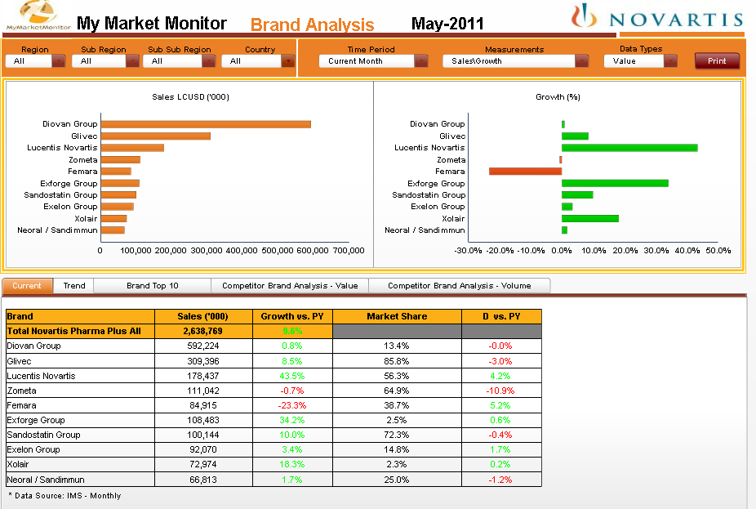
Notes:
+ Graphs: Create lines (to compare) and display numbers (instead of mouse over for IPAD)

Slide 2
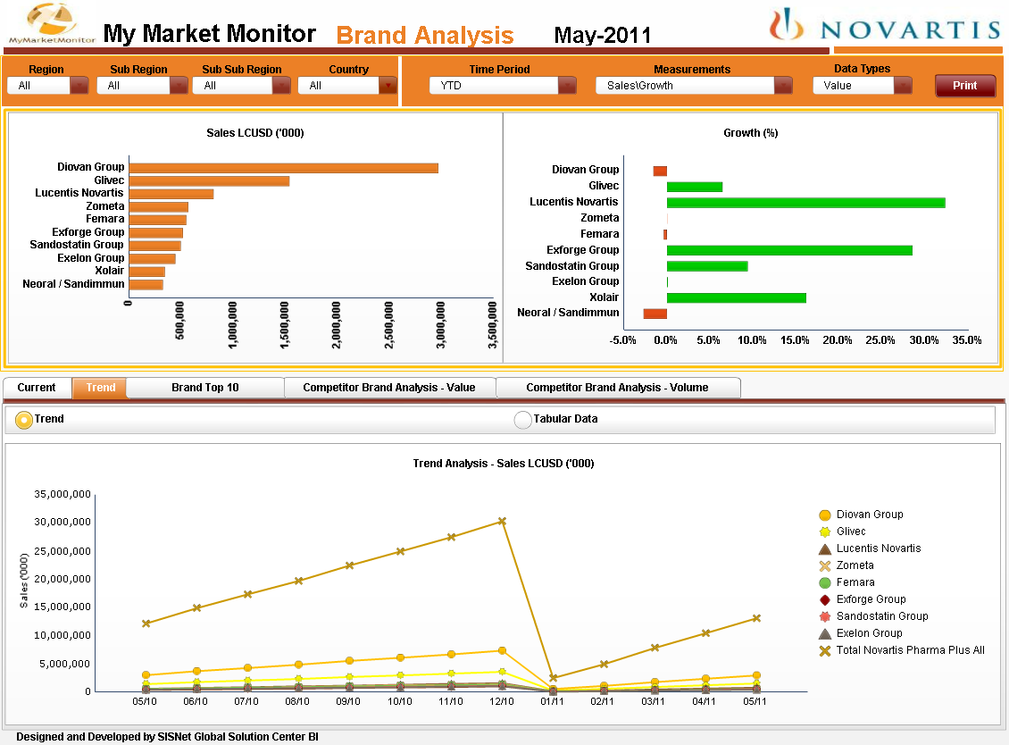
Notes:
To clarify:
- Trend only available when the Time Period is YTD

Slide 3
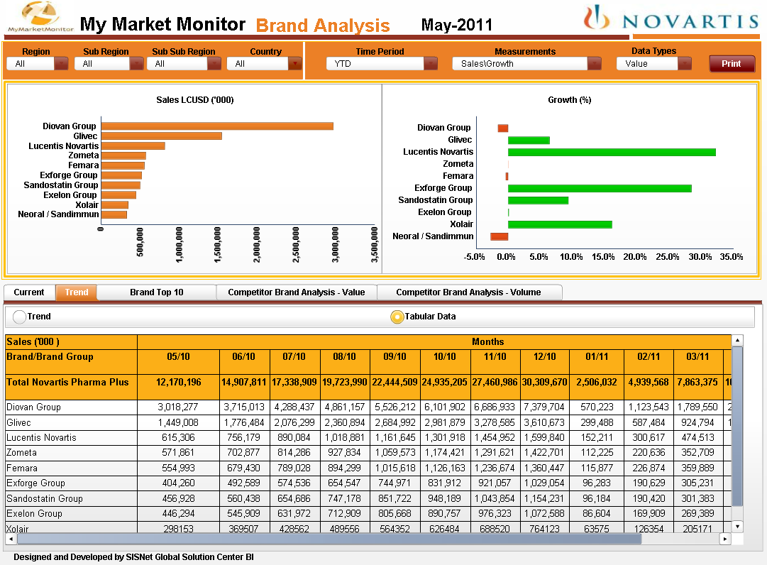
Notes:
+ Number alignment (right)

Slide 4
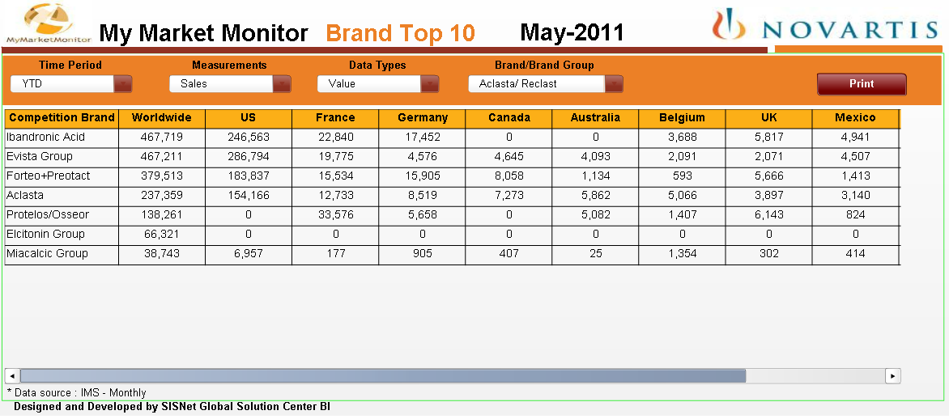
Notes:
+ to identify the Novartis brands
To clarify:
- Need sorting by country?

Slide 5
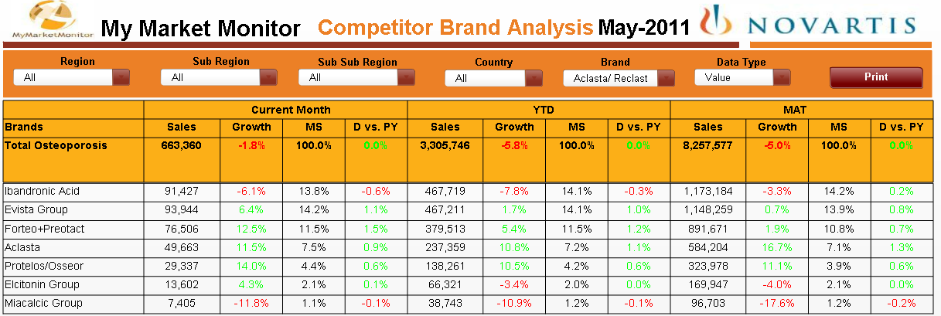
Notes:
To clarify:
- Sort order

Slide 6
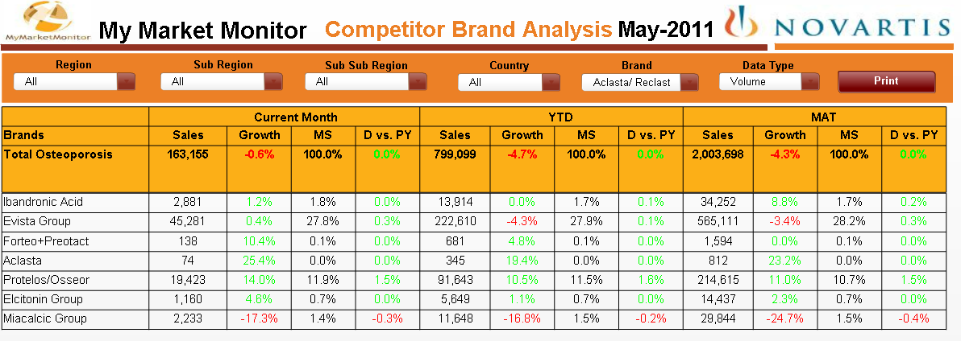

Slide 7
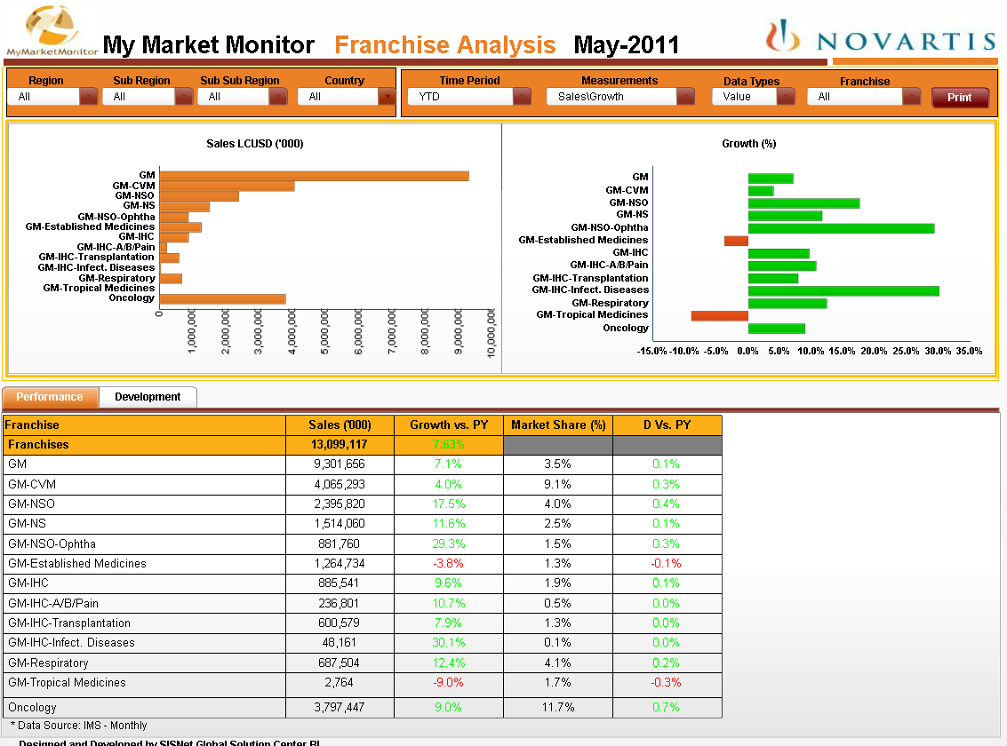

Slide 8
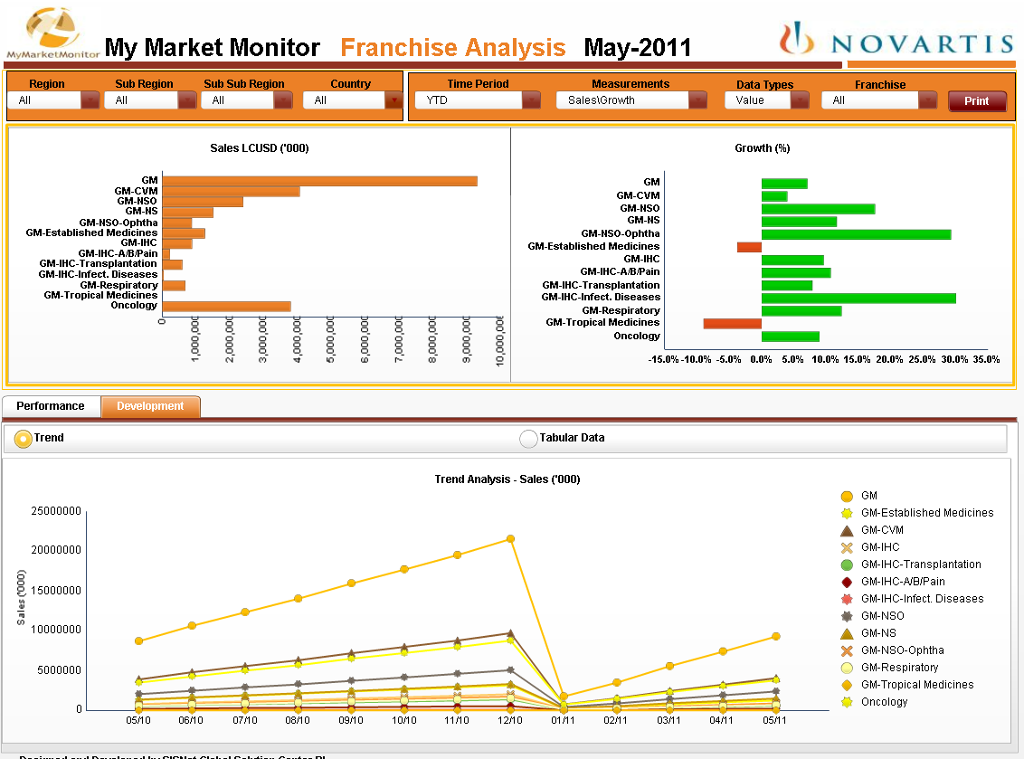

Slide 9
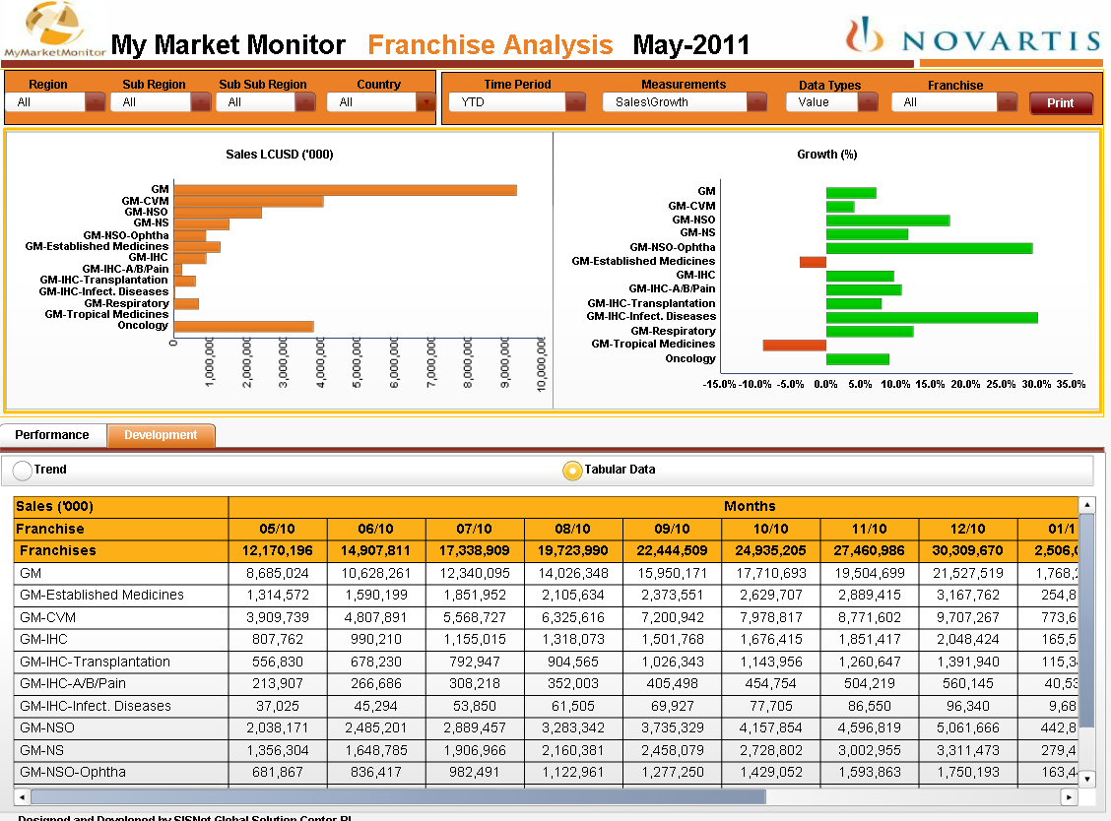

Slide 10
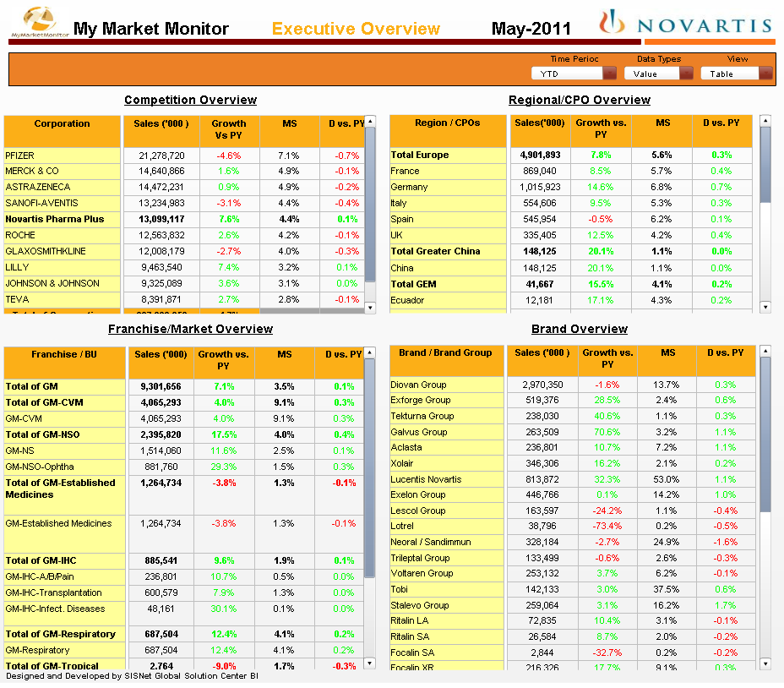

Slide 11
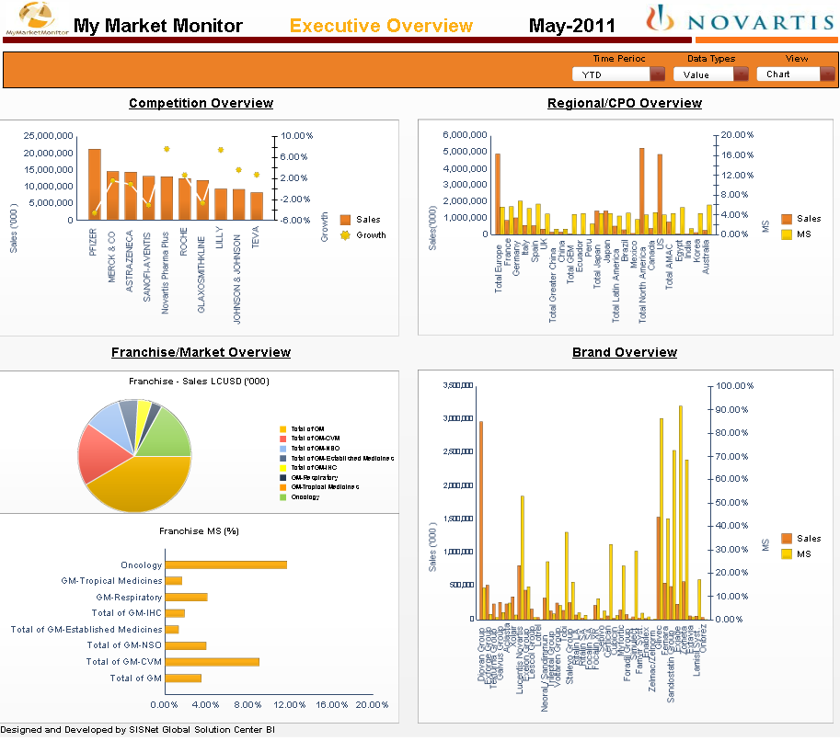
Notes:
To clarify:
Pie chart is useless
Franchise sorted DESC
Regional, not mixing total and details
Competition : Top 5 ? Horizontal bars and sorted
Brands : Top 10? Horizontal bars and sorted

Slide 12
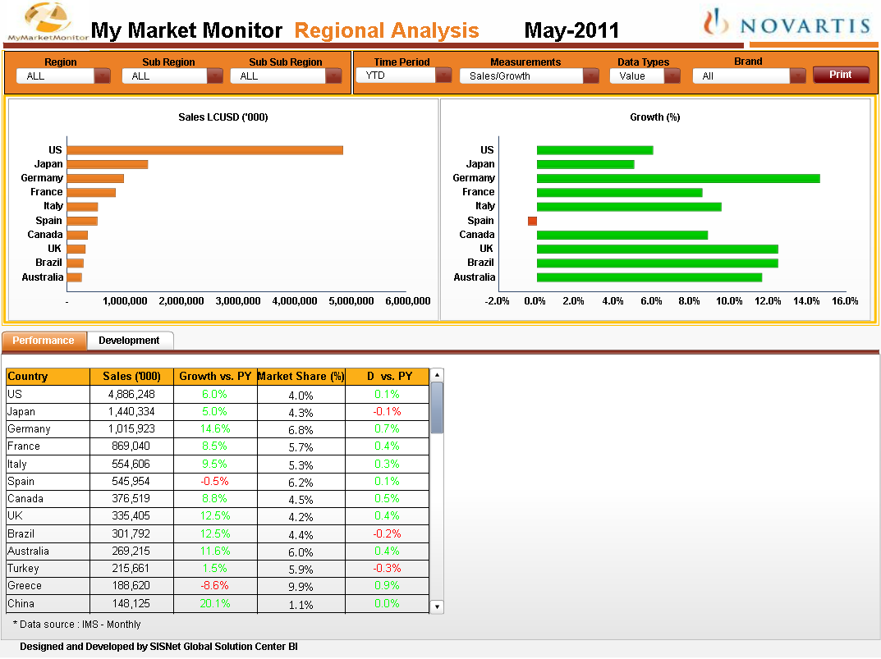

Slide 13
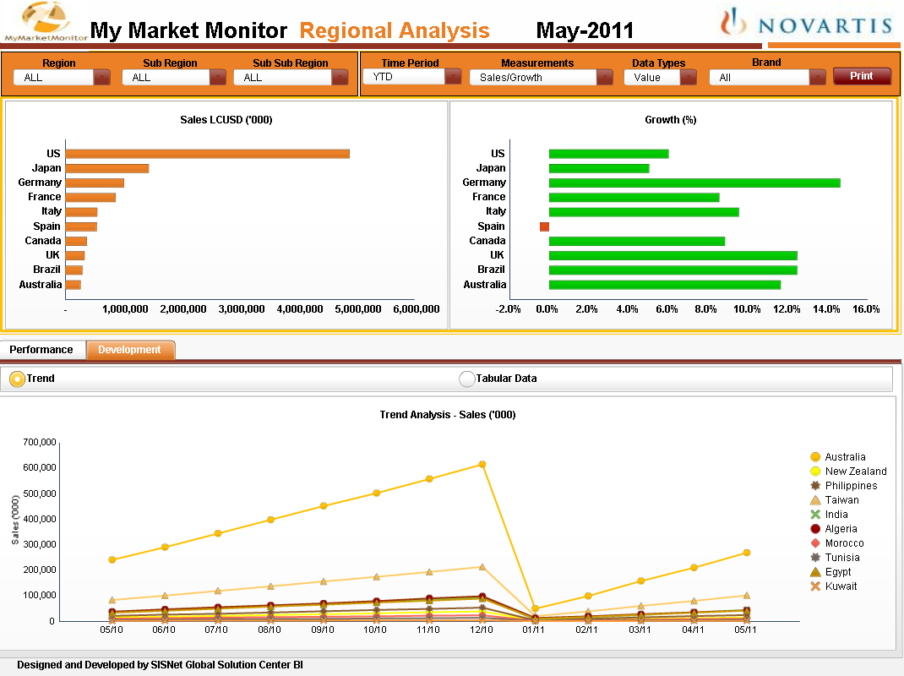

Slide 14
